Slide 1
Understanding COVID-19: The unresolved Issues
Quazi Tarikul Islam
Professor of Medicine
12th September,2020
prof.tarik@gmail.com

Slide 3
CONTENTS
Epidemiology
Behavior of Pathogen
Clinical Presentation
Coagulopathy
HCW/ Frontliners issues
Investigations( viral detection and serology)
Long Term Care
Vaccine issues
Mutation of Virus
Why death rate is low in Bangladesh
Death in MEN is more than WOMEN
Physician’s Burnout

Slide 4
Introduction
During any pandemic, new information circulate (Infodemic).
While many of these new information are facts, some are far from it.
Especially in this age of technology and internet, correct information along with rumors can spread like wildfire in the blink of an eye.
This presents as one of the challenges in the successful handling of the latest pandemic, the Covid-19.

Slide 5
Epidemiology
Identification of the first case: In Wuhan, China
Source: Bat/ SeaFood market/ Pangolin/ Microbiology laboratory of Wuhan, china
Travel Ban: Could it stop spread of the disease ?

Slide 6
As described by the U.S. National Institutes of Health, it is the successor to SARS-CoV-1, the strain that caused the 2002–2004 SARS outbreak.
It is believed to have zoonotic origins and has close genetic similarity to bat coronaviruses, suggesting it emerged from a bat-borne virus.
There is no evidence yet to link an intermediate animal reservoir, such as a pangolin, to its introduction to humans. The virus shows little genetic diversity, indicating that the spillover event introducing SARS-CoV-2 to humans is likely to have occurred in late 2019.
On 3 July 2020, scientists reported finding that a major genetic risk factor for human infection with SARS-CoV-2 was inherited from archaic Neanderthals 60,000 years ago.

Slide 7
Transmission

Slide 8
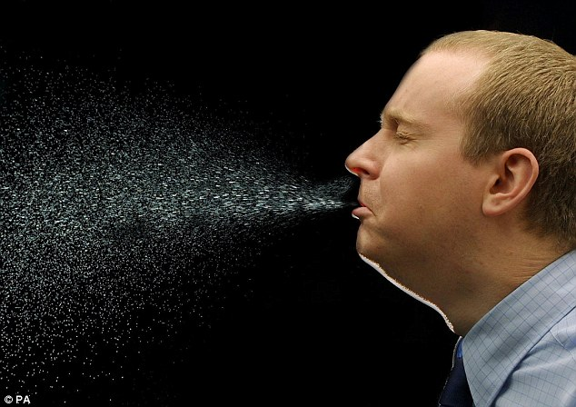
Human to Human transmission
Direct transmission:
Through droplets, ex- coughing and sneezing.
And close contact with oral and respiratory secretions, etc.

Slide 9
Epidemiology
Aerosol transmission: It can spread in air for some time and to infect people longer time than expected before.
Asymptomatic are Super Spreaders

Slide 10
Epidemiology
1st Wave/2nd wave: Where we are now ? Is the answer clear ?
Quarantine : Our people and authority were not serious
Isolation: Except few people did not follow the advise
Lock down: We had no lock Down/ General holiday

Slide 11
Epidemiology
The virus is not prevalent in hot and humid countries.
Younger people are not that much vulnerable to the virus and children cannot get the virus.
Not true. Some viruses, such as cold and flu viruses, do spread more easily in the colder months, but that does not mean that they stop entirely when the conditions are hot and humid.
People of any age can get affected by Covid-19, there is no age differential to get this virus. In Bangladesh middle aged people more affected

Slide 12
Epidemiology
Case incidence is always a good indicator of community risk
Test/Trace/Treat- How much we could achieve ?
The number of new cases in a population does not always reflect the risk of transmission in a community as the composition or distribution of these cases may be very different, even while the overall total is the same. eg: Some cases may be super spreaders
Failed to achieve the target in Bangldesh.

Slide 13
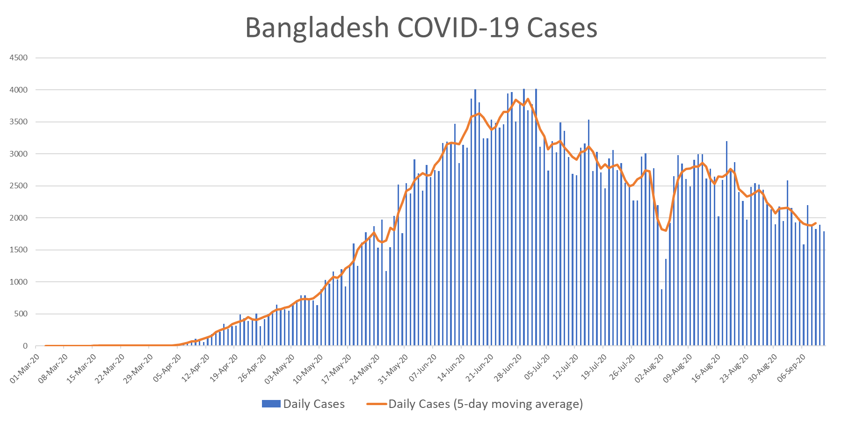

Slide 14
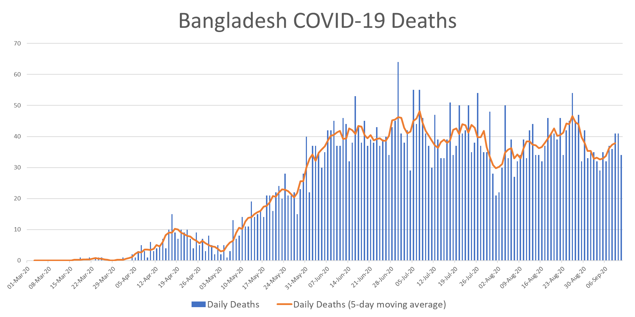

Slide 15
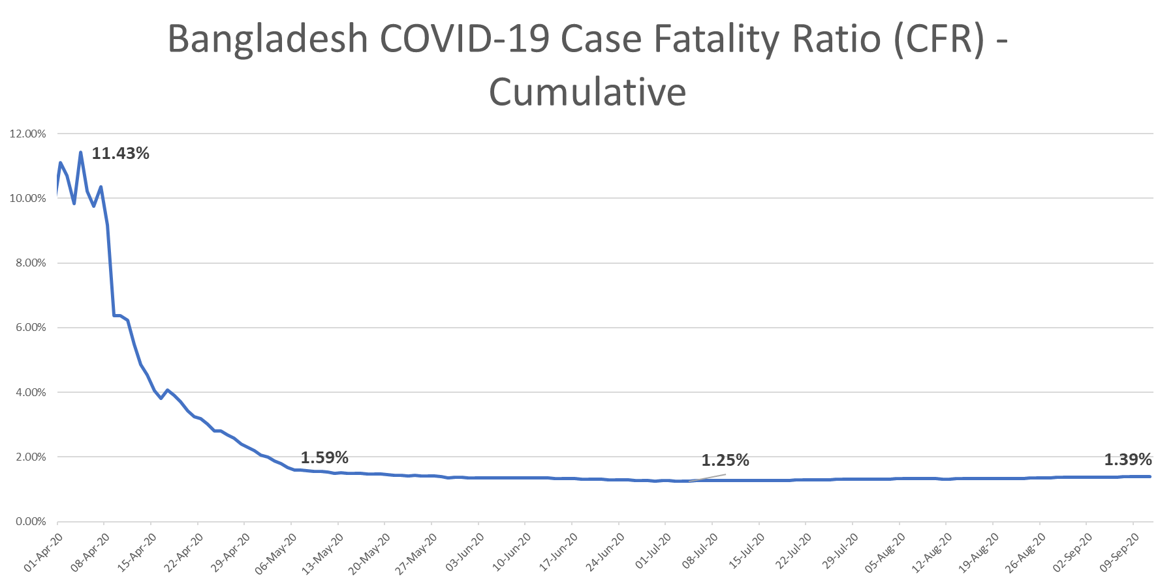

Slide 16
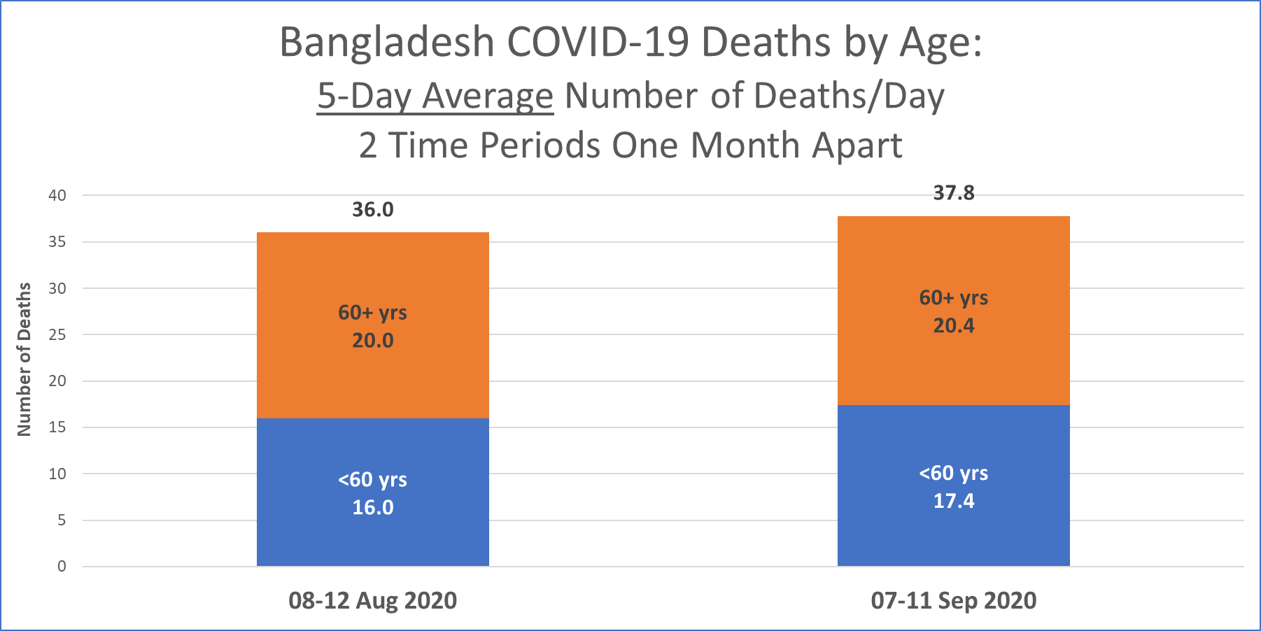

Slide 17
Behavior of Pathogen
Face masks always protect against corona virus
Spraying chlorine or alcohol on the skin kills viruses on the body
No face mask can give 100% protection against aerosolized particles, although they can protect against droplets.
Applying alcohol or chlorine to the body can cause harm, Although people can use these chemicals to disinfect surfaces, These products cannot kill viruses within the body. Disinfectant tunnel is of no use.

Slide 18
Behavior of Pathogen
You can be infected with corona virus in swimming pools
Pet cats and dogs spread corona virus
According to the CDC, there is no evidence to suggest that this virus spreads between people through the water in swimming pools, hot tubs, or water playgrounds.
There have been several reports of pet cats and dogs being infected with the virus, but till not, there is no proof of transmission from them

Slide 19
PNEUMONIA
December 8, 2019, a cluster of cases of “pneumonia of unknown origin” in humans, associated with the Huanan Seafood Wholesale Market, has been reported in Wuhan, China.
Conventional Pneumonia/ COVID -19 ( Where are the CAP, HAP, AP, POI)
Stage of resolution is not usually accompanied by
-sputum production
- para pneumonic effusion
- haemoptysis
ARDS

Slide 20
Who is this Doctor?
Young Chinese Doctor Li Wenliang, who was the first raised voice over Coronavirus, Died From the Disease.

Slide 21
CT scan of chest in COVID- 19
Ground glass opacity
Crazy paving
https://radiologyassistant.nl/chest/lk-jg-1

Slide 22
Chest x-ray
Typically, first-line imaging modality
Less sensitive than CT scan of chest
Commonest: Consolidation
Less common: Ground glass opacity
Bilateral, peripheral, lower zone predominant
Pleural effusion rare.
Ground-glass opacification and consolidation in
right upper lobe and left lower lobe (arrows).
https://radiologyassistant.nl/chest/lk-jg-1

Slide 23
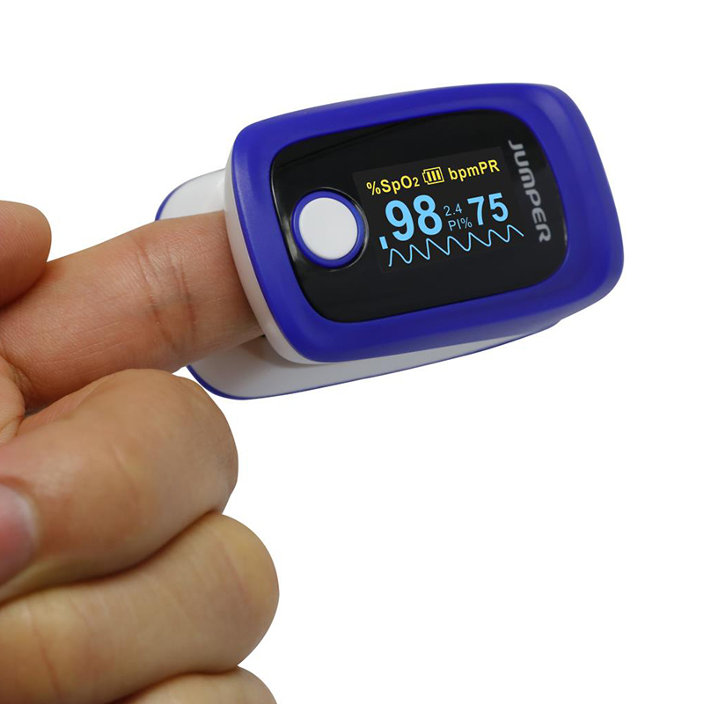
Check at Home
Patient may not feel SOB in the early stage of the disease though there is hypoxia- known as Happy Hypoxia.
Those who could not be diagnosed between 8-10 days that they have bi lateral lung infiltrates, their course of the disease and prognosis goes worst.
These group of patients proceeds to Severe /Critical.

Slide 24
Clinical Presentation and Course
If the disease does not aggravate within first week of symptom onset, you do not need to worry about it
Once you recover from Covid-19, you are free of any future complications
While most cases show signs of deterioration within 10-14 days of symptom onset, some cases have been seen to have a late onset deterioration
Some cases have been seen where patients are presenting with pulmonary fibrosis few months after recovering from the disease

Slide 25
Multi system
Auto immune
CRS
Tropism for ACE2 recepters

Slide 27
Coagulopathy
Thrombosis:
Haemorhage
Postmortem finding: clotting in venous more than arterial vessels
D-dimer

Slide 28
Thrombosis
Hospitalized COVID-19 patients are often elderly, immobile, and show signs of coagulopathy. Therefore, it is reasonable to assume a high incidence of VTE among these patients. Presently, the incidence of VTE is estimated at around 25% of patients hospitalized in the intensive care unit for COVID-19 even under anticoagulant treatment at prophylactic doses.

Slide 29
Several recent studies suggest a hypercoagulable state in patients presenting with COVID-19.
There is a somewhat higher incidence of VTE among hospitalized patients, which is more in high-income countries compared to low- and middle-income countries (3.3 vs. 3%)
In a small study describing autopsies from Brazil, 8/10 patients who died from COVID-19 had pulmonary microthrombi
Yao Y, Cao J, Wang Q, Liu K, Luo Z, Yu K, et al. D-dimer as a biomarker for disease severity and mortality in COVID-19 patients: a case control study. Crit Care Emerg Med. 2020. Available from: https://doi.org/10.21203/rs.3.rs-20850/v1.

Slide 30
Incidence of VTE in Patients with COVID-19
VTE in 27% (95% CI 17–37%) and arterial thrombotic events in 3.7% (95% CI, 0–8.2%).
PE was the most frequent thrombotic complication (n = 25, 81%). Age (adjusted hazard ratio 1.05/year, 95% CI 1.004 -1.01) and coagulopathy, defined as spontaneous prolongation of the prothrombin time >3 s or activated partial thromboplastin time >5 s
Cui S, Chen S, Li X, Liu S, Wang F. Prevalence of venous thromboembolism in patients with severe novel coronavirus pneumonia. J Thromb Haemost. 2020. doi:https://doi.org/10.1111/jth.14830.

Slide 31
VTE
This suggests a causal with infectious etiology and eludes to the fact that COVID-19 patients might also have a higher incidence of VTE due to their inflammatory condition.
In addition, antiphospholipid antibodies that can arise transiently in patients with critical illness and various infections may possibly develop among COVID-19 patients as well.
Zhang Y, Xiao M, Zhang S, et al. Coagulopathy and antiphospholipid antibodies in patients with Covid-19. N Engl J Med. 2020 Apr 23;382(17):e38.

Slide 32
Does a normal D-dimer level effectively rule out PE/DVT?
Yes.
The value of D-dimer testing is the ability to rule out PE/DVT when the level is normal. Although the false negative rate of D-dimer testing (i.e., PE/DVT is present but the result is normal) is unknown in this population, low rates of 1 – 2% using highly sensitive D-dimer assays have been reported in other high risk populations. Therefore, a normal D-dimer level provides reasonable confidence that PE/DVT is not present and anticoagulation should continue at a prophylactic dose rather than empiric therapeutic dosing. In addition, radiological imaging is not necessary when the D-dimer level is normal in the context of low pre-test probability.
COVID-19 and Pulmonary Embolism: Agnes Lee, Maria deSancho, Menaka Pai, Menno Huisman, Stephan Moll, and Walter Ageno; ASH Version 2.0; last reviewed July 20, 2020

Slide 33
Are there any clinical scenarios in which empiric therapeutic anticoagulation would be considered in COVID-19 patients?
Empiric anticoagulation has been proposed in the following scenarios:
Intubated patients who develop sudden clinical and laboratory findings highly consistent with PE, such as desaturation, tachycardia, increased CVP or PA wedge pressure, or evidence of right heart strain on echocardiogram, especially when CXR and/or markers of inflammation are stable or improving.
Patients with physical findings consistent with thrombosis, such as superficial thrombophlebitis, peripheral ischemia or cyanosis, thrombosis of dialysis filters, tubing or catheters, or retiform purpura (branching lesions caused by thrombosis in the dermal and subcutaneous vasculature).
Patients with respiratory failure, particularly when D-dimer and/or fibrinogen levels are very high, in whom PE or microvascular thrombosis is highly suspected and other causes are not identified (e.g., ARDS, fluid overload).

Slide 34
Overall thrombotic complication rate and management in COVID-19
The overall thrombotic complication rate was 9.5% (95% CI, 6.8-12.8; 45 events in 38 patients), or 9.78 per 100 patient-weeks. This included a rate of 4.7% (95% CI, 2.4-8.0), or 5.22 per 100 patient-weeks, in non critically ill patients and a rate of 18.1% (95% CI, 12.1-25.3), or 14.29 per 100 patient-weeks, in critically ill patients.
Forty-one patients (10%) were transitioned from prophylactic-dose to therapeutic-dose anticoagulation during admission to manage thrombotic complications and/or new-onset atrial fibrillation.
COVID-19 and coagulation: bleeding and thrombotic manifestations of SARS-CoV-2 infection; Blood (2020) 136 (4): 489–500.

Slide 35
Bleeding events
The overall bleeding rate was 4.8% (95% CI, 2.9-7.3; 21 bleeding events in 19 patients),
This included a rate of 3.1% (95% CI, 1.4-6.1), or 3.49 per 100 patient-weeks, in non critically ill patients and 7.6% (95% CI, 3.9-13.3), or 5.63 per 100 patient-weeks, in critically ill patients. The major bleeding (WHO grade 3-4) rate was 2.3% (95% CI, 1.0-4.2), or 1.96 per 100 patient-weeks.
COVID-19 and coagulation: bleeding and thrombotic manifestations of SARS-CoV-2 infection; Blood (2020) 136 (4): 489–500.

Slide 36
Mechanism of clot formation
Endothelial injury – There is evidence of direct invasion of endothelial cells by the severe acute respiratory syndrome coronavirus 2 (SARS-CoV-2) virus, potentially leading to cell injury. Some experts have postulated that endothelial injury plays a central role in the pathogenesis of acute respiratory distress syndrome and organ failure in patients with severe COVID-19.
Other sources of endothelial injury include intravascular catheters and mediators of the acute systemic inflammatory response such as cytokines (eg, interleukin [IL]-6) and other acute phase reactants. The contribution of complement-mediated endothelial injury has been suggested.
Teuwen LA, Geldhof V, Pasut A, Carmeliet P. COVID-19: the vasculature unleashed. Nat Rev Immunol 2020; 20:389.
Begbie M, Notley C, Tinlin S, et al. The Factor VIII acute phase response requires the participation of NFkappaB and C/EBP. Thromb Haemost 2000; 84:216.

Slide 37
Mechanism of clot formation
Stasis – Immobilization can cause stasis of blood flow in all hospitalized and critically ill patients, regardless of whether they have COVID-19.
Hypercoagulable state – A number of changes in circulating prothrombotic factors have been reported or proposed in patients with severe COVID-19 .
Elevated factor VIII
Elevated fibrinogen
Circulating prothrombotic microparticles
Neutrophil extracellular traps (NETs)
Hyperviscosity
Panigada M, Bottino N, Tagliabue P, et al. Hypercoagulability of COVID-19 patients in intensive care unit: A report of thromboelastography findings and other parameters of hemostasis. J Thromb Haemost 2020; 18:1738.
Ranucci M, Ballotta A, Di Dedda U, et al. The procoagulant pattern of patients with COVID-19 acute respiratory distress syndrome. J Thromb Haemost 2020; 18:1747.

Slide 38
HCW/Frontliners
Duty roster of Physicians issue
Quarantine issue
Accommodation
Food
Transport
It is not luxury
How scientific the authority is ?

Slide 39
Role of Professional bodies
BMA
Swachip
BSM
Health forum
Journalists
Media
NTAC

Slide 40
Investigations
RT-PCR = Positive – Persistent/True/False
Negative – True/False
Rapid Antigen Test: WHO yet do not give clearance for this test
Antibody Test : COVID-19 antibodies can disappear after 2-3 months of Infection, Ralph Elis;WebMD,19 June, 2020

Slide 41
Post COVID Syndrome
Rehabilitation
Management
- Follow up
- New Normal life
- Drugs
- Psychiatric intervention

Slide 42
Vaccine
172 countries and multiple candidate vaccines engaged in COVID-19 vaccine Global Access Facility - WHO
Nine CEPI-supported candidate vaccines are part of the COVAX initiative, with a further nine candidates under evaluation, and procurement conversations on-going with additional producers not currently receiving research and development (R&D) funding through COVAX – giving COVAX the largest and most diverse COVID-19 vaccine portfolio in the world
80 potentially self-financing countries have submitted non-binding expressions of interest to the Gavi-coordinated COVAX Facility, joining 92 low- and middle-income economies that are eligible to be supported by the COVAX Advance Market Commitment (AMC)
Goal of bringing the pandemic under control via equitable access to COVID-19 vaccines needs urgent, broadscale commitment and investment from countries

Slide 43
Where we are ?
The New York Times/August, 2020

Slide 46
A collaboration between Serum Institute of India (SII), Gavi and the Bill & Melinda Gates Foundation announced earlier this month will ensure up to 100 million doses of AstraZeneca or Novavax’s candidate vaccines, if successful, will be available to low- and middle-income economies through the COVAX Facility at just US$ 3 per dose

Slide 47
GAVI/COVAX/AMC
In July the Gavi Board agreed on the 92 economies that will be supported the COVAX Advance Market Commitment (AMC). The full list is as follows:
Lower-middle income: Angola, Algeria, Bangladesh, Bhutan, Bolivia, Cabo Verde, Cambodia, Cameroon, Comoros, Congo, Côte d'Ivoire, Djibouti, Egypt, El Salvador, Eswatini, Ghana, Honduras, India, Indonesia, Kenya, Kiribati, Kyrgyztan, Lao People’s Democratic Republic, Lesotho, Mauritania, Micronesia, Moldova, Mongolia, Morocco, Myanmar, Nicaragua, Nigeria, Pakistan, Papua New Guinea, Philippines, São Tomé and Principe, Senegal, Solomon Islands, Sri Lanka, Sudan, Timor-Leste, Tunisia, Ukraine, Uzbekistan, Vanuatu, Vietnam, West Bank and Gaza, Zambia and Zimbabwe

Slide 48
COVID-19 vaccine: Bangladesh to get priority if China develops vaccine
China has said Bangladesh will get priority in terms of cooperation and support if they can successfully develop vaccine for the coronavirus.
"Of course, Bangladesh is our important friend and Bangladesh will surely get priority," Deputy Chief of Mission at Chinese Embassy in Dhaka Hualong Yan told UNB on Sunday.
He said Bangladesh and China are working closely to deal with the situation amid the coronavirus outbreak.

Slide 49
Govt approves human trial of Chinese Covid-19 vaccine in Bangladesh- Dhaka Tribune Aug 27,2020
icddr,b has been approved to conduct the trial of the vaccine, developed by Sinovac
The government has given approval to the phase 3, or human, trial of a Covid-19 vaccine in Bangladesh, developed by the Chinese company Sinovac Biotech Ltd.
Story

Slide 50
The AstraZeneca vaccine trial was halted after a person enrolled in it developed a rare inflammatory condition.
Adar Poonawalla's Serum Institute Gets Notice on Pausing Vaccine Trial
Top U.S. health officials update Congress on vaccine development and distribution plans.

Slide 51
Some peoples of all countries should be vaccinated on priority than all peoples of some countries –
Dr. Tedros, DG, WHO
September 7,2020

Slide 52
VACCINE
One thing is for sure, we are well on our way to developing vaccines for people all over the world. The WHO is coordinating global efforts to develop a vaccine, with an eye toward delivering two billion doses by the end of 2021.
How far you believe ???
WHO Bulletin,August 2020

Slide 53
Bangladesh
Beximco Pharmaceutical did a MOU with SERUM Institute of India for taking part in trial and having the vaccine on priority.

Slide 54
Bangladesh
is set to discuss the trial of Oxford University’s Covid-19 vaccine, developed in collaboration with British pharmaceutical company AstraZeneca. The vaccine is undergoing final stage trials in different countries. Serum Institute of India is also set to begin trials of the vaccine in India this week.
bdnews24

Slide 55
Challenges to be faced once a vaccine is available
People may not be convinced to take the corona virus vaccine
The virus may mutate, rendering the vaccines ineffective
The immunity from the vaccine may not last long
The challenge in distributing the vaccine
Maintenance of cold chain and preservation
Prioritization of Vaccination according to WHO

Slide 56
HOW MANY PEOPLE NEED TO BE VACCINATED
It is hard to know without knowing how effective the vaccine is going to be.
It is thought that 60-70% of people need to be immune to the virus in order to stop it spreading easily (known as herd immunity)
That would mean billions of people around the world would need to be vaccinated for the vaccination program to be successful.
BBC News

Slide 57
Mutation of Virus
160 times the COVID19 virus has been mutated in the last six months in Banhladesh.
Unresolved issues:
a. After mutation, Virus become weaker/stronger ?
b. Will this mutation of Virus influence vaccination ( prepared from other strain in other country)

Slide 58
COVID-19 Special: Coronavirus burnout
Eight months into the coronavirus pandemic, people around the world are fed up with coronavirus restrictions. Thousands have taken to the streets to protest government-imposed rules in recent weeks. But with a vaccine likely still months away, growing impatience with restrictions is threatening to exacerbate the spread of the virus. August /2020

Slide 59
RESTAURENT in September, UK

Slide 60
Back to school—but not for all
Many schools around the world have reopened after shutting their doors earlier this year due to the corona virus. But not everywhere. Some schools have opted for remote classes or even decided to remain closed because of safety concerns in USA, UK .
In Bangladesh all educational Institutions are closed till 3rd October,2020. Incidence of COVID-19 is not yet in single digit (5%). All institutions are taking class/exam online.

Slide 61
Are we expecting secondary infection?

Slide 62
Reactivation/Reinfection

Slide 64
Management and Long-term Care
CRS can be treated with IL6 inhibitors effectively.
Flu and pneumonia vaccines can protect against Covid-19
No evidence have been found so far
As SARS-CoV-2 is different than other viruses, no existing vaccines protect against infection

Slide 65
Why death rate is low in Bangladesh
Nationwide successful EPI in our credit
Cross immunity may play a significant role
Young and middle aged group(20-39 years) are affected 48% so recovery is very good
More than 60 years of age – 12% only affected which is increasing in last 3 weeks

Slide 66
Why MEN suffer and die of COVID more than WOMEN
GENDER
GENETICS/ HORMONES
IMMUNITY
BEHAVIOR

Slide 67
Why COVID-19 is Hitting Men Harder Than Women
Several studies have shown that more men are dying from COVID-19 than women.
Experts say part of the reason is women tend to have stronger immune systems than men.
They add that men also tend to engage in more risky behavior such as ignoring physical distancing, and they don’t take symptoms as seriously.

Slide 68
GENDER
Men
Pay less attention to their health,
Smoke and take alcohol more
Eat less nutritiously.
Unhealthy lifestyle
Generally wait longer before seeing a doctor.
Data gathered in more than 20 countries by the research initiative Global Health 50/50 confirms that women are infected with the virus as frequently as men. But men are more likely to contract severe forms of COVID-19 and die from the infection. The ratio of mortality according to sex is about one-third to two-thirds.

Slide 69
GENETICS
A very basic fact is that women have two X chromosomes per cell whereas men have one. "A number of critical immune genes are located on the X chromosome,".
In particular, the X chromosome contains a gene for a protein called TLR7, which detects single-stranded RNA viruses like the coronavirus.
"As a result, this protein is expressed at twice the dose on many immune cells in females compared to males, and the immune response to coronavirus is therefore amplified in females.

Slide 71
HORMONE
Estrogen and a stronger immune system
The female immune system is also more resilient than that of men. The main reason for this is the female sex hormone estrogen. It stimulates the immune system so it acts faster and more aggressively against pathogens. The male hormone testosterone, on the other hand, inhibits the body's own defenses.

Slide 72
The Y chromosome and hormones
The Y chromosome contains hardly any genes other than SRY but it is full of repetitive sequences (“junk DNA”).
Perhaps a “toxic Y” could lose its regulation during ageing. This might hasten ageing in men and render them more susceptible to the virus.
But a bigger problem for men is the male hormones unleashed by SRY action. Testosterone levels are implicated in many diseases, particularly heart disease, and may affect lifespan

Slide 73
Hiding in the testes?
New research offers men seem to clear SARS-CoV-2 from their bodies more slowly than women do. To explain that possibility, researchers have suggested the virus may have found a hiding place in men: the testes.
Previous research has shown that SARS-CoV-2 invades certain human cells by plugging into these cells' ACE2 receptors. So, the researchers consulted a database, and found that the testes have high levels of ACE2 expression. In contrast, ACE2 could not be detected in the ovaries, the female equivalent of the testes.
However, the research did not actually look in the testes to see if SARS-CoV-2 is hanging out there, so "it does not tell us whether the virus infects testes or whether it is a reservoir of virus,”

Slide 74
CARE FREE

Slide 75
Now, having this positive correlation between ACE 2 and coronavirus, different studies quantified the expression of ACE 2 proteins in human cells based on gender ethnicity, for example, in studying the expression level and pattern of human ACE 2 using a single-cell RNA-sequencing (RNA-seq), analysis indicated that Asian males had higher expression of ACE 2 than female.
Zhao Y, Zhao Z, Wang Y, Zhou Y, Ma Y, Zuo W. Single-cell RNA expression profiling of ACE2, the receptor of SARS-CoV-2. BioRxiv Prepr. 2020. 10.1101/20200126919985.

Slide 76
Nevertheless, a clear picture of the epidemiology of this Covid-19 is not yet well understood, but it is now becoming clear that being male is also a factor. While it is still too early to determine why the gender gap is emerging, this article point to several possible factors such as genetics, immunology, and behavioral as the associated factors.
Guan W, Ni Z, Hu Y, Liang W, Ou C, He J, et al. Clinical characteristics of coronavirus disease 2019 in China. N Engl J Med 2020;1–13.

Slide 77
To generate an appropriately controlled response during infections, immunological checkpoints, such as the inhibitory CD200 receptor (CD200R), greatly play a great role in balancing the immune system during microbial infection by stimulating and controlling hyper immune mediated response.
Karnam G, Rygiel TP, Raaben M, Grinwis GCM, Coenjaerts FE, Ressing ME, et al. CD200 receptor controls sex-specific TLR7 responses to viral infection. PLoS Pathog. 2012;8(5):1–8. doi: 10.1371/journal.ppat.1002710. [CrossRef] [Google Scholar

Slide 78
The concept of sex-based immunological differences driven by sex hormone and X chromosome has been well described by Elgendy where blocking estrogen receptors increased the mortality due SARS-CoV infection among female mice, suggesting the role played by estrogen receptors in blocking some viral infection.
Elgendy IY, Pepine CJ. Jo ur of. Int J Cardiol [Internet]. 2020. 10.1016/j.ijcard.2020.05.026

Slide 79
Covid Kills More Men Than Women. Experts Still Can’t Explain Why
A new tracker from Harvard’s Gender Sci Lab is the first to consolidate sex-separated data from across the US. It may help researchers solve the mystery.

Slide 80
CHILDREN
Children are not spreaders
In any case, the age distribution of COVID-19 cases differs significantly from that of other infectious diseases, where children are often considered "super-spreaders" because they spread a virus quickly throughout the population.
This is not the case with the new coronavirus, according to a much-noticed study commissioned by government of the German state of Baden-Württemberg. The study is now serving as the basis for a rapid and comprehensive return to normal operations in daycare centres and schools, provided that hygiene standards and distancing rules are observed.

Slide 81
CHILDREN
Children less at risk
Surprisingly, children are not among the weakest members of society when it comes to the new coronavirus — in most children, the disease it causes takes a comparatively mild and often asymptomatic course. Of the around 9,000 people who have died of COVID-19 in Germany since the beginning of the pandemic, only three were under 18 years of age.
The reason for this is not yet fully understood. Doctors assume that the already innate "unspecific system" is effective in small children. As protection against the first pathogens, the mother gives her own specific immune protection to the fetus and later to the newborn via breast milk.

Slide 82
CHILDREN
This "passive immunization" usually lasts until children have built up their own defense system. Children develop their specific immune defense up to the age of about 10. And even after that, their defense system remains capable of learning throughout their lives when new pathogens appear.

Slide 83
Our Heroes, Our Frontline Fighters
Most Stressed Out

Slide 84
Physician’s Wellbeing-ACP

Slide 85
Burn Out Depressed Doctors

Slide 86
More than half (59.0%)had moderate to severe levels of perceived stress (PSSscores ≥14).
1509 (29.8 percent), 681
(13.5 percent) and 1218 (24.1 percent) HWs reported stress, depression and anxiety symptoms

Slide 87
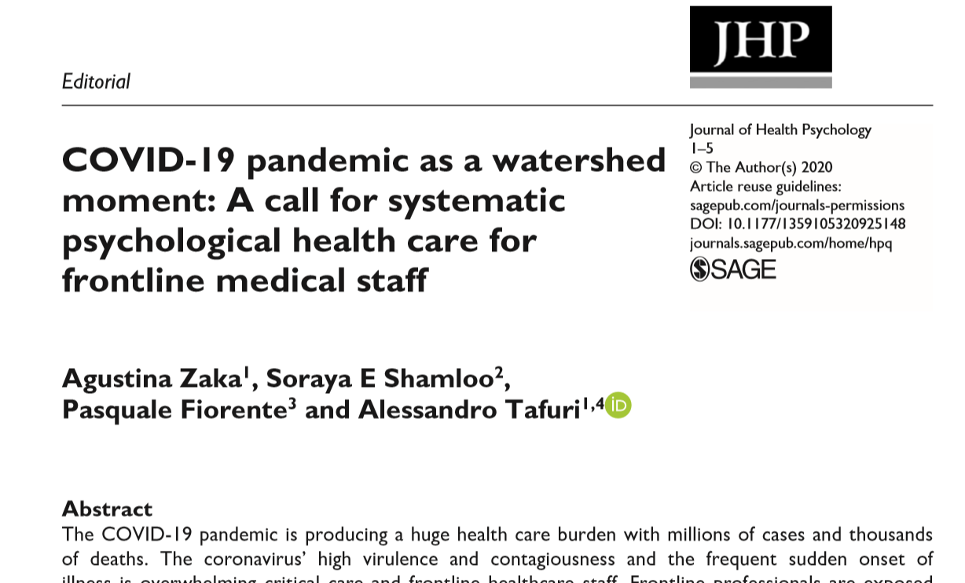

Slide 88
Improve Your COPING SKILL

Slide 89
Unburden Yourself
Stressor control
STRESS

Slide 90
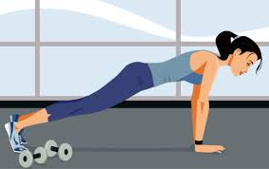
REGULAR EXERCISE
Relaxation

Slide 91
Relaxation
i. Breathing exercise (deep breathing)
Slowly breathe in from abdomen and then breath-out slowly for 10-15 times per sitting
ii. Meditation
Any spiritual activity

Slide 92
মানসিক প্রস্তুতি রাখুন
Think ahead and try to ANTICIPATE varieties of possibilities, good or bad
কঠিণ অবস্থা অনুযায়ী কিছু পরিকল্পনা রাখুন

Slide 93
“there is no formula or operating manual for how to cope with the current global pandemic’’

Slide 94
Organizational Level
স্বাস্থ্য বিভাগ
হাসপাতাল কতৃপক্ষ
Community Level
মিডিয়া
সাধারণ জনগন
সহকর্মী
Individual Level
Notes:
Listening to their anxieties, ensuring adequate protection, training health care professionals to provide appropriate care, supporting them and extending care to their families are important ways to help health professionals help others.

Slide 95
Organizational Level
টিম ম্যানেজারের দায়িত্ব
স্বাস্থ্যবিভাগ
হাসপাতালকতৃপক্ষ

Slide 96
টিম ম্যানেজারের দায়িত্ব
ট্রেনিং
ডিউটিতে অভিজ্ঞ এবং অনভিজ্ঞ স্টাফদের একসাথে মিলিয়ে রাখা
ডিউটিতে কর্মবিরতি নিশ্চিত করা
উর্ধতন কর্তৃপক্ষের সাথে নিয়মত যোগাযোগ

Slide 97
ডিউটি রোটেশনে খুব চাপদায়ক এবং কম চাপদায়ক দায়িত্বগুলো

Slide 98
টিম ম্যানেজারের দায়িত্ব
রেগুলার মিটিং
সঠিক তথ্য স্পষ্টভাবে সরবরাহ করা
মানসিক চাপ বিষয় কথা বলা
মানসিকভাবে বিপর্জস্ত হলে সাপোর্ট দেয়া
রোগীর মৃত্যুতে মনের প্রতিক্রিয়া প্রকাশে সহায়তা
Notes:
Communication is also crucial following the pandemic, in order to reduce employees’ uncertainty and their level of stress.
Indeed, providing clear and transparent information about the organization’s future plans may reduce the fear of the unknown.

Slide 99
টিম ম্যানেজারের দায়িত্ব
মানসিক স্বাস্থ্য সহায়তা সম্পর্কে অবহিত হওয়া
কেউ মানসিকভাবে বিপর্জস্ত হলে মানসিক স্বাস্থ্য সেবা নিশ্চিত করা
উৎসাহ দেয়া, কৃতজ্ঞতা প্রকাশ
Notes:
zero-tolerance policy (anti-discrimination) (Stewart, 2018) is a valuable tool to protect employees, prevent stigma, and enhance health

Slide 100
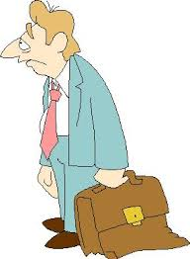
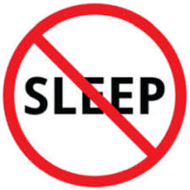
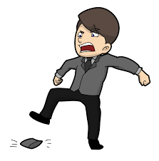
WARNING SIGN Being Extremely Stressed Out
Sadness, tearfulness,
or hopelessness
Being inactive,
lack of energy
Forgetful and
poor performance
Over eating
Difficulty sleeping
or changes in sleep
Mood swings
Trouble thinking
or making decisions
Irritability
Impaired concentration
Recurring nightmares
Notes:
Psychological distress and depression are the results of an intense or a continuous stress which has not been managed, mainly due to the individual’s difficulty to cope with stressful life events (Cummins et al., 2015; Drapeau et al., 2011; Marchand, 2004). The current pandemic is a source of intense stress for the whole world population.

Slide 101
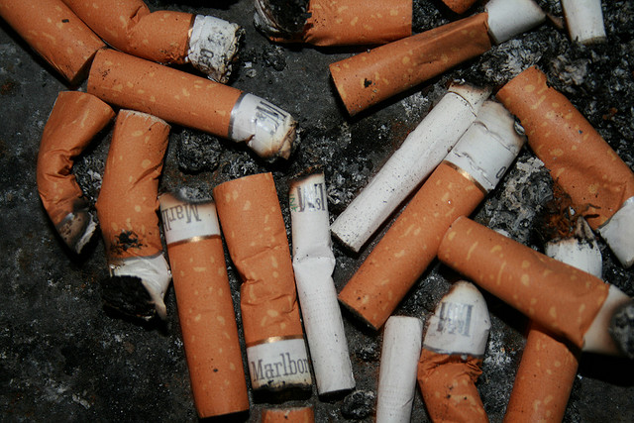
Unwanted Stress Reaction (Warning Signs)
Drug addiction,
Use of medication Excessive smoking

Slide 102
Indications for referral for mental health assessment
Expressing suicidal ideas
Violent/aggressive behaviour
Uncontrolled use of alcohol/drugs
Crying or expressing uncontrollable distress
Unexplained bizarre behaviour like talking or smiling to self
Significant deterioration in occupational functioning

Slide 103
Ensure Breaks
Make Yourself
RELAXED

Slide 104
Acknowledgement
Dr. Mekhola Sarker, Assoc. Prof of Psychiatry, NIMH
Dr. Shams el Arefin, ICDDR,B

Slide 105
THANK YOU

